Slide 1
Climate, Location, Natural Resources, and Population Distribution of Europe

Slide 2
Where do people live in the UK, Russia, and Germany?

Slide 3
Country #1: United Kingdom
Location: Coast of Western Europe, across the English Channel
Climate: 1. Mild with frequent rainfall. Leads to abundant arable land.
2. Heavily impacted by gulf stream ocean currents
Natural Resources: coal, iron ore, natural gas, petroleum
Population Distribution: In urban areas (cities) - LONDON

Slide 4
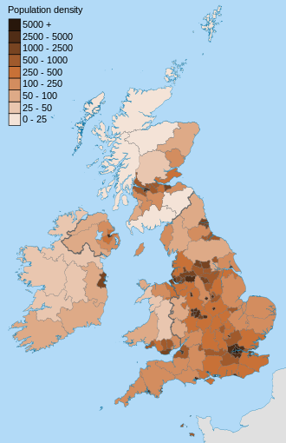
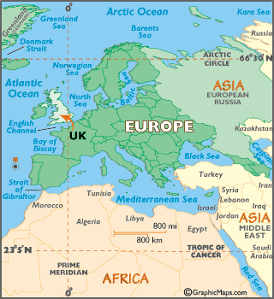

Slide 5
Country #2: Russia
Location: Both Europe and Asia
Climate: Cool summers and harsh winters, Asian side has permafrost (permanently frozen ground)
Natural Resources: Timber, mining of oil, natural gas, gold, iron ore, and coal found in Ural mountains and throughout Russia. ***difficult to extract due to the permafrost
Population Distribution: Most Russians live on “Europe Side” - 77%. Largest City is Moscow

Slide 6
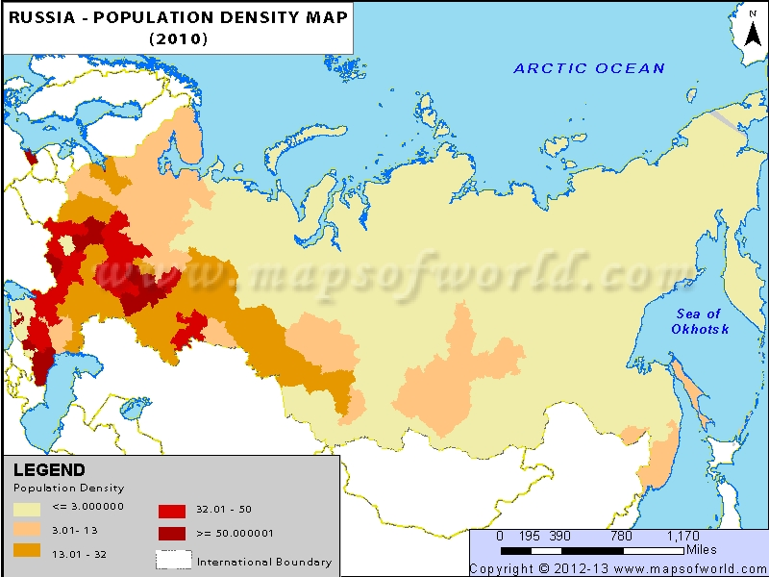
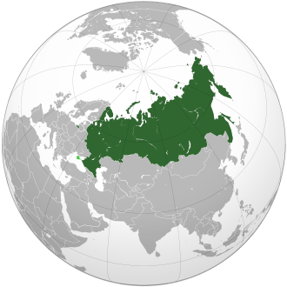

Slide 7
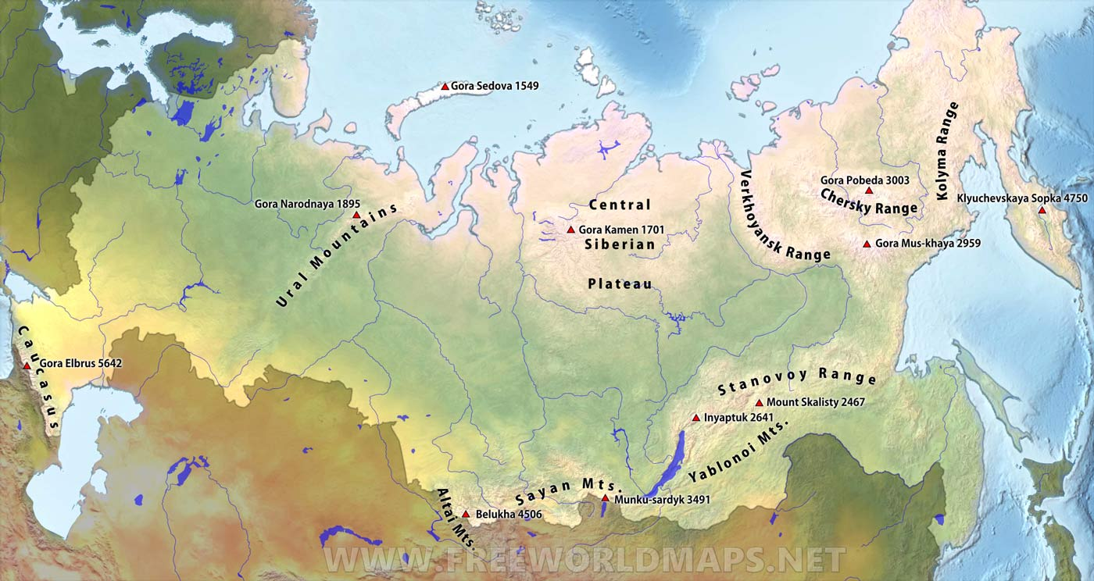

Slide 8
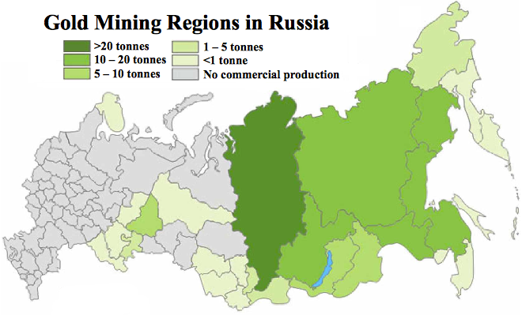

Slide 9
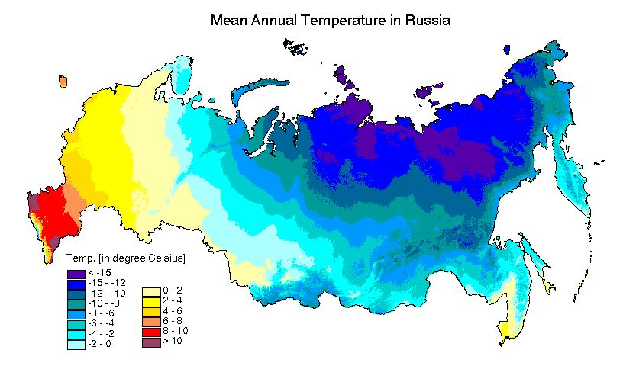

Slide 10
Country #3: Germany
Location: Central Europe - bordered by many countries
Climate: Western Side: warm summers with mild winters
Eastern Side: cold harsh winters, long hot summers
Natural Resource: 1. coal and iron ore that supports its auto industry and energy industry
2. Abundance of arable land and timber industry
Population Distribution: Mostly urban (cities) in WEST Germany near Rhine River. Rhine plays major role in transporting goods and people. Biggest city: Berlin (east)

Slide 12
