Slide 1
Languages of Europe
Guten
Tag
Bonjour
Buongiorno
Добрый
дењ
Good
Morning
SS6G11 The student will describe the cultural characteristics of Europe
a. Explain the diversity of European languages as seen in a comparison of German, English, Russian, French, and Italian

Slide 2
Europe is slightly larger than the US in land area and Europe’s population is more than double the US
In the US, English is the dominant language
Europe is different. It is home to more than 200 languages

Slide 3
Most European languages are in 3 main categories
Germanic Languages
Romance Languages
Slavic Languages

Slide 4
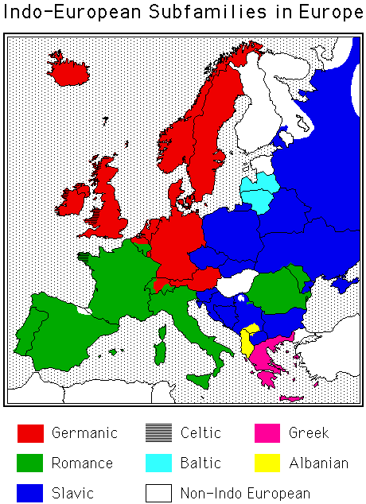
Which countries speak Germanic languages?
Which countries speak Romance languages?
Which countries speak Slavic languages?
What are some of the other smaller groups?

Slide 5
Which countries speak Germanic languages?
Which countries speak Romance languages?
Which countries speak Slavic languages?
What are some of the other smaller groups?

Slide 6
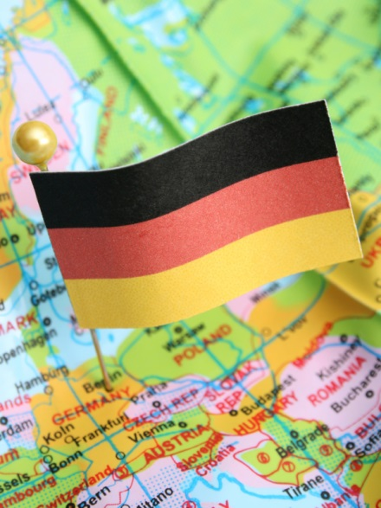
Germanic Language Group
Has most native speakers
Native speakers live mostly in northwest and central Europe
About 20% of Europeans speak English or German as their native language
Most Europeans learn English
as a second language
in their schools

Slide 7
Romance Language Group
This group includes French, Italian, and Spanish
These are found in the south and west of Europe
These languages come from Latin, the language of the Roman Empire
The Roman alphabet is used to write Romance and Germanic languages

Slide 8
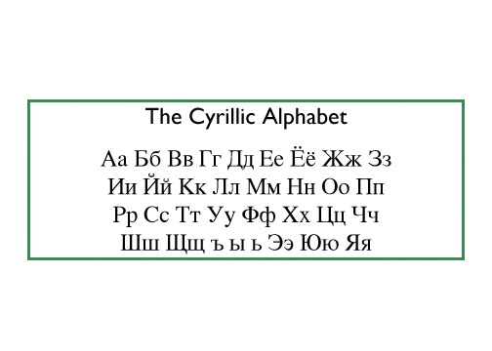
Slavic Language Group
This includes Russian
They are found in central and eastern Europe
They are written with a Cyrillic Alphabet

Slide 9

The Problems with Multiple Languages
It is difficult to live, work, and trade with people who cannot communicate with each other
Most schoolchildren learn one or two other languages besides their own

Slide 10

The European Union have 23 “official” languages to make sure laws and decisions are understood
Special laws exist to protect languages spoken by only a few people

Slide 11

http://tts.imtranslator.net/I1SX
Lee: Do you understand the words that are a-coming out of my mouth?
Carter: Don’t nobody understand the words that are comin’ out of your mouth

Slide 12
Your Task
Write G for Germanic, R for Romance, and S for Slavic.
This language family is primarily spoken in the United States.
This language family is spoken in the country that is shaped like a boot.
This language family includes Russian
French is a part of this language family
Ukrainian is in this language family

