Slide 1
Environmental Issues in Europe

Slide 2
Air Pollution in the United Kingdom
Definition:
Air that contains gases, dust, fumes or odor in harmful amounts that could be harmful to the health or comfort of humans and animals or which could cause damage to plants and materials.
Causes
Smoke from Factories/Power stations burning coal
Vehicle emissions
Effects
Damage to vegetation
Harm to the atmosphere
Harm to humans (lungs, nose, eyes, causing asthma & pneumonia) Blackens buildings
Harms wildlife
People can’t go outside as often (elderly & children)
Solution(s)
Smokeless zones using only those fuels
Laws force automakers make cars with less harmful exhaust
Government regularly checks air quality

Slide 3
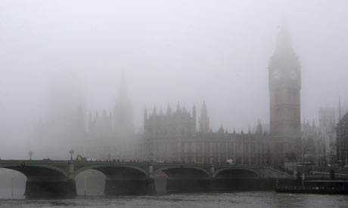
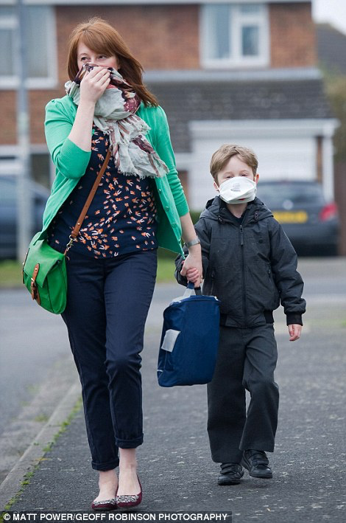
Air pollution in the United Kingdom
https://alexisgarciabiology3.files.wordpress.com/2014/05/air-pollution-the-houses-001.jpg
http://www.dailymail.co.uk/news/article-2595840/UK-weather-Experts-divided-smog-cloud-actually-exists.html

Slide 4
Acid Rain in Germany
Definition: Rainfall made acidic by pollution that causes environmental harm, typically to forests and lakes.
Causes
Air Pollution
Acid rain occurs when factories’ smoke or vehicles’ exhaust containing sulfur dioxide and nitrogen oxides go up into the atmosphere and come back down to earth in the form of harmful precipitation (rain, snow, etc.).
Burning of fossil fuels
Effects
Harms vegetation/plant life
Destroyed half of Black Forest
Damage to lakes, rivers and streams
Contamination of drinking water
Damage to buildings and monuments
Sulfur deposits from acid rain are carried through the air causing acid rain in other countries in Europe.
Solution(s)
Hydroelectric power
Regulations to reduce emissions from cars and factories
New types of energy: solar & wind turbine

Slide 5
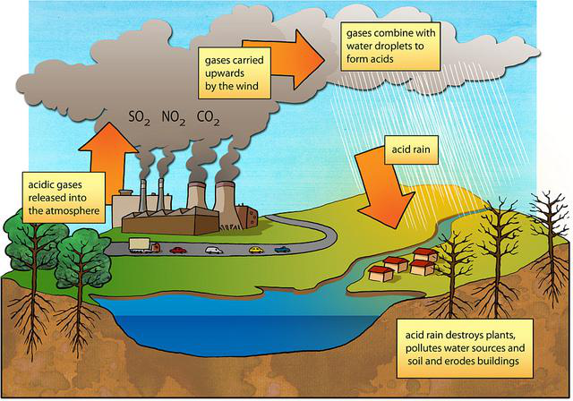
Acid Rain
https://s3.amazonaws.com/ai2-vision-textbook-dataset/dataset_releases/rc2/train/question_images/acid_rain_formation_6502.png

Slide 6
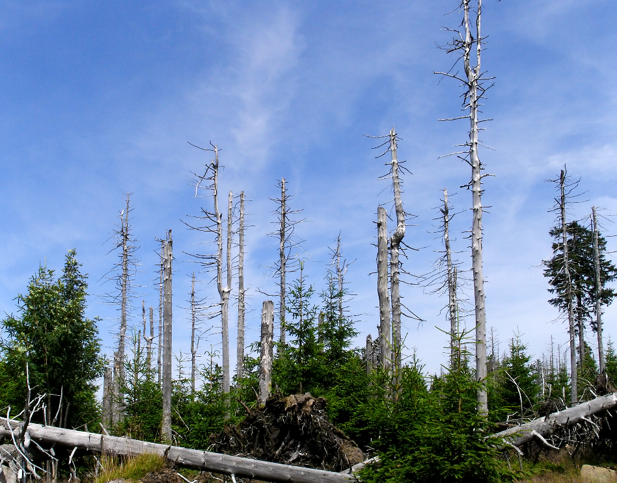
Images of Effects of Acid Rain
From Wikimedia Commons
From Wikimedia Commons

Slide 7
Nuclear Disaster in Chernobyl, Ukraine
Definition:
Nuclear accident to those events that emit a certain level of radiation which could harm people
Causes
Unsafe reactor Workers lacked training
Workers made a mistake while testing the reactor, causing a steam explosion and fires
Effects:
28 to 31 people died; over 300,000 people evacuated
Animals & fish died and were unsafe to eat for years
Farmland was destroyed causing food shortages
Those exposed had increased rate of cancer
Wind carried radiation to other countries
Solution(s)
Bury / contain objects
Clean and control the spread of dust that contain radiation
Area around Chernobyl remains deserted

Slide 8
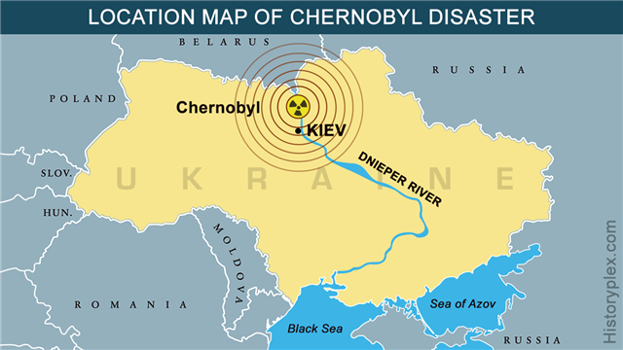
Nuclear Disaster at Chernobyl
https://historyplex.com/facts-timeline-aftermath-of-1986chernobyl-nuclear-disaster

Slide 9
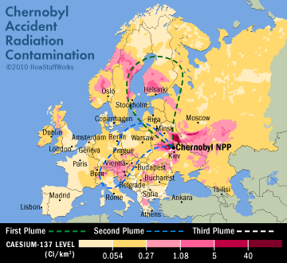
https://rememberfukushima.org/fallout-maps/
Notes:
Science behind it: https://www.youtube.com/watch?v=f5ptI6Pi3GA

Slide 10
Resources for Air Pollution in the United Kingdom
Video Clip – This site has an article and 90 second video clip – Scroll down to see the video clip
http://www.telegraph.co.uk/news/0/high-air-pollution-city-does-compare-themost-polluted-cities/
UK air pollution: How bad is it? – Article
http://www.bbc.com/news/uk-26851399
How bad is air pollution in the UK? (6 March 2017) – Article
http://www.bbc.com/news/science-environment-38979754
What is causing the UK's high levels of air pollution? (2 Apr 2014) – Article
https://www.theguardian.com/environment/2014/apr/02/what-causing-uk-high-level-air-pollution
How can the UK reduce air pollution? (16 February 2017) - Article
http://www.bbc.com/news/uk-38990192
Images: This is a good site for images for air pollution in the United Kingdom
http://www.dailymail.co.uk/news/article-2595840/UK-weather-Experts-divided-smog-cloud-actually-exists.html

Slide 11
Resources for Acid Rain in Germany
Germany - controversially - still bombards forests with limestone to combat acid rain – Article (11-19-13)
http://www.dw.com/en/germany-controversially-still-bombards-forests-with-limestone-to-combat-acid-rain/a-17239231
How is the Forest Affected by Acid Rain?- Article (April 25, 2017)
https://sciencing.com/forest-affected-acid-rain-4475.html
Articles that explain causes, effects and possible solutions but are not specific to Germany.
https://www.nationalgeographic.com/environment/global-warming/acid-rain/
https://www.thoughtco.com/acid-rain-definition-1434936
Infographic – Use of wind turbines –
https://1-stromvergleich.com/wind-power-germany/#facts
Environmental Issues: Acid Rain (Britannica.com) – Video Clip (Published on Feb 7, 2007 older clip but information is good)
https://www.youtube.com/watch?v=hdXtZFoYA_4

Slide 12
Resources for Chernobyl Nuclear Disaster
4/28/1986: Chernobyl Disaster – ABC News – Video
http://abcnews.go.com/Archives/video/chernobyl-disaster-nuclear-plant-soviet-1986-9843882
Chernobyl: The World's Worst Nuclear Disaster – Video (Now This World - Published on May 10, 2015)
https://www.youtube.com/watch?v=hLkv_j3BxF
Infographic - Chernobyl Nuclear Disaster 25 Years Later - By Karl Tate, LiveScience Infographic Artist | April 25, 2011)
https://www.livescience.com/13858-chernobyl-nuclear-disaster-25-years.html
Watch as Chernobyl nuclear site is encased in a massive new tomb (time lapsed video clip - Published on Nov 30, 2016)
https://www.youtube.com/watch?v=mHorhPALCBU
Chernobyl 31 years on: making the area safe again – Text (teacher use)
https://ec.europa.eu/europeaid/sectors/energy/nuclear-safety/chernobyl-feature-story_en
Chernobyl 30 years on: The EU's response – From the European Parliament Think Tank (European Union)
http://www.europarl.europa.eu/thinktank/en/document.html?reference=EPRS_BRI(2016)580887
Chernobyl: The World's Worst Nuclear Disaster - Facts & Overview of Accidents (Video – Flash Back- Published on Dec 26, 2015)
https://www.youtube.com/watch?v=7VBGoXs7czQ

